Slide 1

Hack2Future
LTM x Microsoft Hackathon Partnership
Solution Submission : Team ReportRangers

Slide 2







Hack Team
YUVRAJ SINGH
SIYARAM SHARMA
SAHIL RAMESH CHAWLA
ABHISHEK DAMODAR BAPAT
ADITYA JALINDAR LAD
JATIN LALIT CHAUDHARI
 | Description
Team Name | ReportRangers
Chosen Challenge Statement | How can AI automate and unify learning analytics to improve workforce readiness and eliminate manual reporting?
Idea Name | Learning Report Agent for Unified Analytics
Problem Statement | Learning and workforce data is highly fragmented across LMS, SharePoint, Excel, and HR systems. This creates heavy manual reporting efforts, delayed insights, and inconsistent metrics, leaving leadership without real-time visibility into workforce readiness.

Slide 3
Technical Architecture

Slide 4
Technical Architecture
 | Description
Core Components (Microsoft Technology / Services Touched) | Data Foundation: Azure Data Factory (Orchestration), and Azure Databricks (Medallion Architecture / Delta Lake). Application Interface: Streamlit (Serves as the unified front-end, replacing standard BI dashboards). AI Analytics Engine: LangChain Experimental Pandas Agent (Dynamic routing that executes Python code in real-time instead of hardcoded SQL). Language Model (POC): Local Llama 3.1 via Ollama (Built to easily swap to Azure OpenAI GPT-4o for production). Enterprise Dashboards: Power BI (DirectQuery on Gold layer for standard, real-time L&D metrics). Automated Reporting: Matplotlib (JSON-driven charting) and FPDF (Automated landscape PDF generation).
Safe AI Execution & Data Governance | Data Minimization & Isolation: The AI agent queries decoupled, pre-aggregated CSV extracts (Gold Layer Materialized Views), ensuring zero direct access to raw HR databases. Execution Sandboxing: Separation of concerns—the LLM is restricted to generating JSON specifications for charts, while Matplotlib safely handles the visual rendering to prevent prompt injection crashes. Enterprise Data Guardrails: Unity Catalog (column-level PII masking) and RBAC are enforced at the Databricks Gold Layer before data is passed to the application. Deterministic Fallbacks: Regex-based query routing bypasses the LLM entirely for standard KPI requests, eliminating hallucination risks for critical workforce metrics.

Slide 5
Solution Approach
 | Description
Relevance to Challenge | Directly targets fragmented L&D data by ingesting 7 different sources and processing them through a strict Medallion Architecture. Computes 5 critical KPIs and delivers instant insights via a Hybrid Streamlit + LangChain Pandas Agent, completely closing the workforce visibility gap end-to-end.
Innovation & Creativity | Cost-Optimized AI via LRU Semantic Caching: Drastically reduces LLM API costs and query latency by caching frequent analytical requests. Agentic Execution Sandbox: The LLM does not hallucinate numbers; it writes and executes Python code natively against the dataframes to calculate exact metrics. Novel KPI-Driven Voucher Engine: Turns passive L&D data into actionable rewards by auto-qualifying learners for vouchers based on a custom Weighted Engagement Score (5 weighted signals), tracked with a full audit trail.
Technical Implementation | Pipeline: ADF ingestion → PySpark Silver → Delta Gold (Star schema) → Materialized Views → Streamlit + LangChain AI Agent. Advanced Gold Layer Optimizations: Zero full overwrites. Utilizes incremental MERGE statements for CDC (Change Data Capture) and maintains strict SCD Type 2 history. Delta Time Travel: Built-in version history allows for seamless rollbacks and precise audits of data deletions or real-time ingestion errors.
User Experience | Unified Streamlit Hub: A single pane of glass for L&D managers. Features instant, deterministic tables for standard lookups, and a natural language chat interface for complex analytics. Automated Deliverables: Auto-generates Matplotlib visual charts and 1-click downloadable FPDF reports. Zero SQL or BI training required.
Impact & Scalability | Sub-second Latency: Achieved through the strategic use of Materialized Views and LRU caching, handling 476+ users and 7 unified sources effortlessly. Highly Scalable Foundation: The rigorous use of incremental MERGE and SCD2 history makes the architecture natively ready for structured streaming transitions.
Presentation & Pitch | Problem: 7 siloed L&D datasets causing reporting delays and blind spots. Solution: An optimized Medallion pipeline feeding a cost-conscious, hybrid AI Agent. Demo Highlights: Real-time dynamic chart generation, semantic caching speed-ups, and automated PDF reporting.
Adaptability & Flexibility | Supports any tabular source via ADF and a schema-driven Silver layer. Decoupled Architecture: The use of Materialized Views cleanly separates the analytical frontend from the raw data, allowing seamless future migration of the application layer to Azure App Services and Azure OpenAI.
Overall Impression | A highly optimized, production-ready POC showcasing strong Data Engineering principles. Combines robust, ACID-compliant Medallion pipelines with a practical, hallucination-free AI application that prioritizes cost-efficiency and accuracy.
Why does your POC/Tool worthy of GTM development ? | Enterprise-Ready & Cost-Effective: It merges rigorous data warehousing (CDC, SCD Type 2) with a cutting-edge hybrid AI router. By leveraging semantic caching and executing real Python logic instead of relying on pure LLM reasoning, it provides an enterprise-safe, hallucination-free analytics engine that is built to scale sustainably on Azure.

Slide 6
Star Schema

Slide 7
ER Diagram

Slide 8
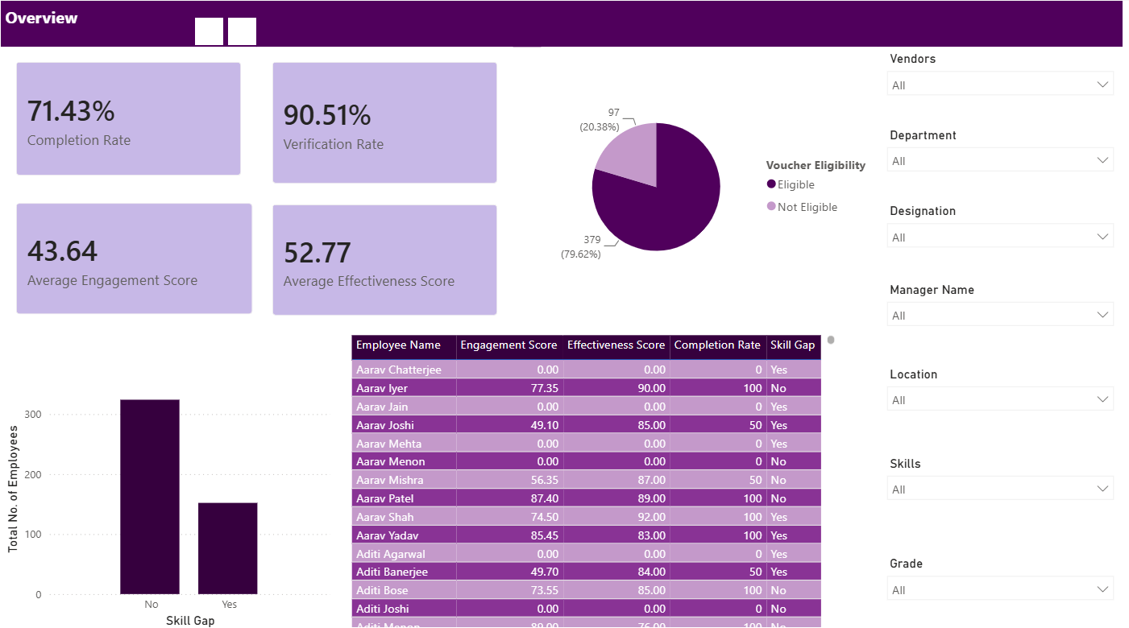
Power BI Dashboard Insights
Overview

Slide 9
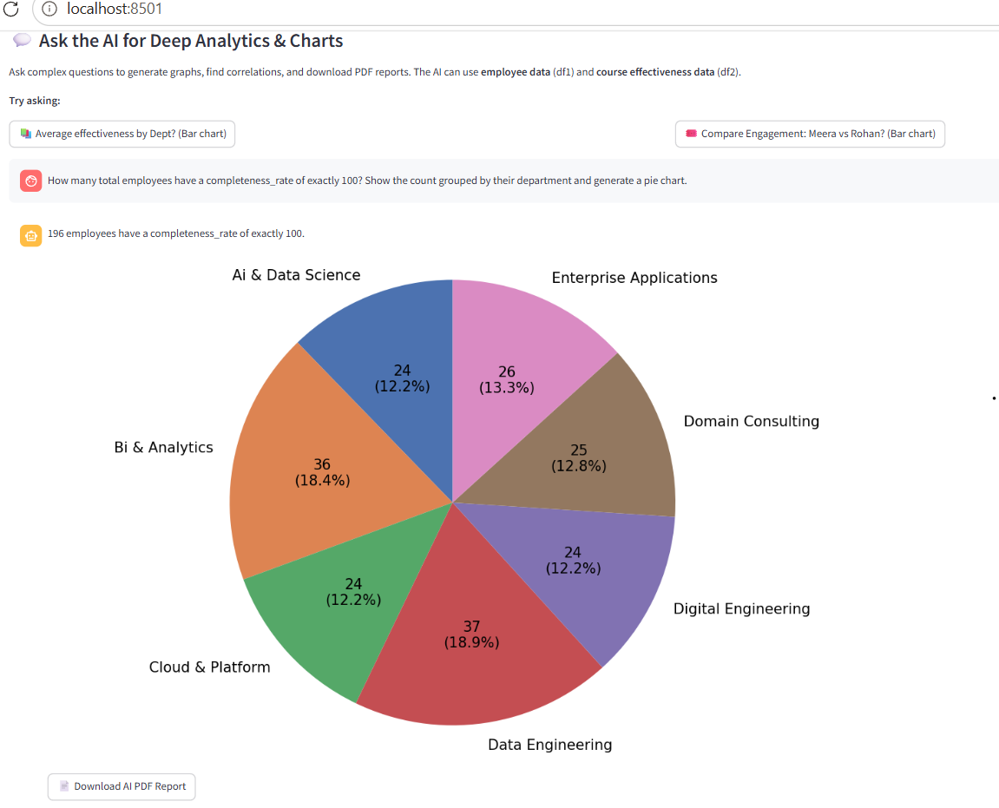
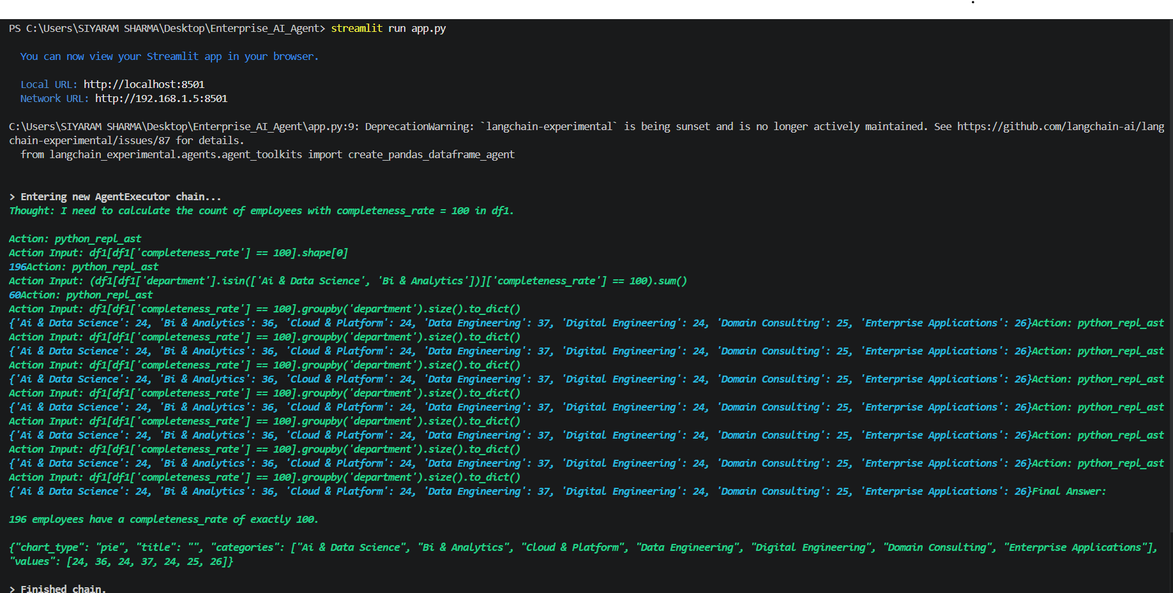
The AI Brain: Streamlit UI vs. LangChain Execution

Slide 10
THANK YOU

